Slide 1
Industry 4.0 Topic: Interenet of Services
Prepared by: A K Pati

Slide 2
Internet of Services (IoS)
The Internet of Serivices (IoS) enables the service vendors to offer their services via the Internet
It refers to the interconnection and interaction of various services through internet.
Services and functions are represented as software components and made available by providers via the Internet (cloud)
The objective of IoS is present everything on the Internet as a service, including software applications, platforms for developing and delivering these applications, and underlying infrastructures (CPUs, storage, networks, and so on).
The IoS is characterized by availibilty which is measured in terms of average service availability over a given time period
Factors that affect availability are reliability and resiliency

Slide 3
The Industry 4.0 depends on CPS and IoT technologies. These two concepts are converging to the Internet of Services that provide a set of serviceses

Slide 4
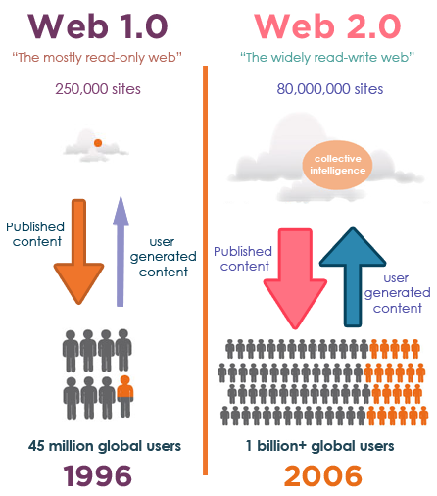
The term Internet of Services raised from the convergence of other two concepts: Web 2.0 and Service-oriented architecture(SOA).
The intersection of these two fields is the notion of reusing and composing existing resources and services
Web 2.0:
“Web 2.0 is the business revolution in the computer industry caused by the move to the internet as a platform, and any attempt to understand the rules for success on that new platform.”– Tim O’ Reilly.
It’s a simply improved version of the first worldwide web, characterized specifically by the change from static to dynamic or user-generated content and also the growth of social media.

Slide 5
Web 2.0 is characterized by four aspects: interactivity, social networks, tagging and web services.
Interactivity: which comes from two technologies: AJAX (Asynchronous JavaScript and XML) that allow the communication and the dynamic manipulation of data between a server, and the web browser.
Social networks: based on common interests, making the information from each network available through different ways.
Tagging: through which users can add a keyword as a tag to certain web content, making this tag easily reachable when searched by other users.
Web services: which allow that other software makes use of the features offered by a web application, being available not only to people but also to machines

Slide 6
Service Oriented Architecture (SOA):
SOA is a way of designing and building a set of Information Technology applications where application components and web services make their functions available on the same access channel for mutual use.
The SOA can be explained through two different angles.
From a business perspective, it represents a set of services that improve the capability of the company to conduct business with customers and suppliers.
From a technology perspective, it is a project philosophy characterized by modularity, separation of concerns, service re-uses, and composition, as well as a new programming method base

Slide 7
The SOA services characteristics should be:
Technology neutral: they must be invoked through standardized lowest common denominator technologies that are available to almost all IT environments. This implies that the invocation mechanisms (protocols, descriptions and discovery mechanisms) should comply with widely accepted standards.
Loosely coupled: they must not require knowledge or any internal structures or conventions (context) at the client or service side.
Support location transparency: services should have their definitions and location information stored in a repository such as UDDI and be accessible by a variety of clients that can invoke the services irrespective of their location.

Slide 8
Classification of IoS
The IoS can be classified as business service, e-service and web service
Business service:
In these domains, a service is considered to be an activity which is intangible by nature.
It is defined as business activities provided by a service provider to a service consumer to create a value for the consumer.
Services are considerably different from products primarily due to their intangible nature.
Services lack of concrete characteristics. Thus, services must be defined indirectly in terms of the effects they have on consumers
Business services may be performed by humans also
Examples: cutting hair, painting a house, typing a letter, or filling a form, processing an insurance claim is also considered a service

Slide 9
Web Services:
It is defined as “a software system designed to support interoperable machine-to-machine interaction over a network”.
Web Services on-line delivery functionalities (called services) offer simple input and output interfaces – hiding its internal structure and programming language – that can be used by other Web Service, software application or machine, as well as humans.
The web services can identify in three types: RPC Web Services, SOA Web Services, and RESTful Web services.
E-Service:
e-service is a collection of network-resident software services accessible via standardized protocols, whose functionality can be automatically discovered and integrated into applications or composed to form more complex services.
E-services are services for which the Internet (or any other equivalent network such as mobile and interactive TV platforms) is used as a channel to interact with consumers.

Slide 10
Examples of IoS:
In the IoS vision, services are seen as tradable goods that can be offered on service marketplaces by their providers to make them available for potential consumers.
Tesla is delivering vehicles with hardware and software which can be upgraded, their cars are sensor ready and software upgrades will provide extra intelligence, delivered via the internet. The customer could pay for the upgrades which then generates extra revenue for Tesla.
Otis is supplying elevators/lifts with sensors which send data into their cloud. The data is analyzed and Otis sells a predictive maintenance services package, again adding a long-term revenue stream.
eBay , Amazon , Flipcart….

Slide 11
Challenges in IoS:
Scalability of services: Although there are many services that are static in nature from the view pint of their size but still the services experiences fluctuations due to workload.
Monitoring of Services: Most of the mechanism of billing including payment as offered by providers are based on resources of individual users as per their consumption time based on unit.
Context awareness of applications: One of the key challenges of the future of IoS is to address the increase in the information relevancy within a given context. Need to be more aware in specific application and services such as social networking, computational environment and various other mobile applications.
This context awareness adapts certain behaviors related to the environment such as activity of users, accessing of devices, location or people who are nearby.

